Slide 1
Gel Scramble Lab 1
William Grisham, Ph.D.
Copyright 2014

Slide 2
Pedagogical Goals
1) Enhanced critical thinking skills
2) Dealing with unexpected data
50% of ALL experiments in science don’t “work”
Having strategies to deal with unexpected data are important
Unexpected data can reveal important discoveries
Need to rule out alternative explanations first
Explaining unexpected data can lead to good troubleshooting protocols

Slide 3
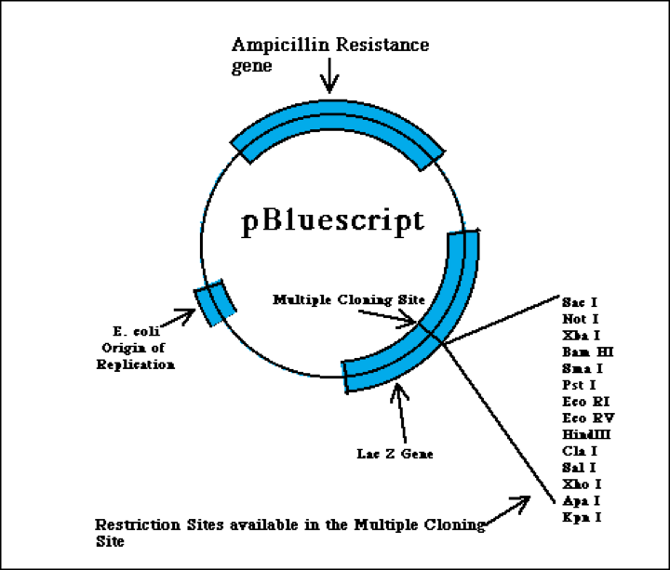
2961 bp
Notes:
From
http://www.bio.davidson.edu/Courses/Molbio/MolStudents/spring2003/Keogh/plasmids.html#basicplasm

Slide 4
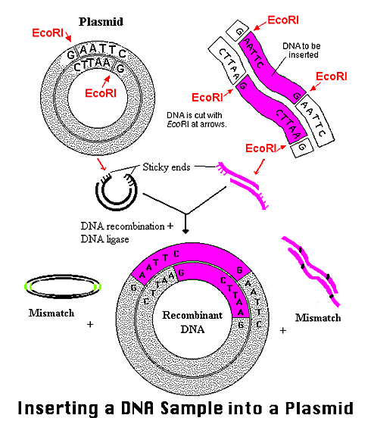
Notes:
From
http://www.bio.davidson.edu/Courses/Molbio/MolStudents/spring2003/Keogh/plasmids.html#basicplasm

Slide 5
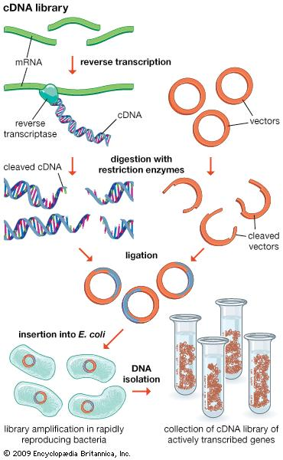
Notes:
From
http://media-1.web.britannica.com/eb-media/45/117845-004-7A5A589A.jpg

Slide 6
First Big Objective
Identify the gel that goes with a given insert
First step is to take each gene+plasmid and determine the fragments expected from digestion via the protocols
Need to use the info about the gene (reference number or sequence)
Need to use information about the vector (plasmid)

Slide 7
Getting Started
1) The protocols from the website for enzymes used in digest https://mdcune.psych.ucla.edu/modules/gel
2) cDNAs for each of 6 mystery DNAs—Entrez gene reference numbers given in manual
3) The vector, which is to say the plasmid—characteristics given in the manual

Slide 8
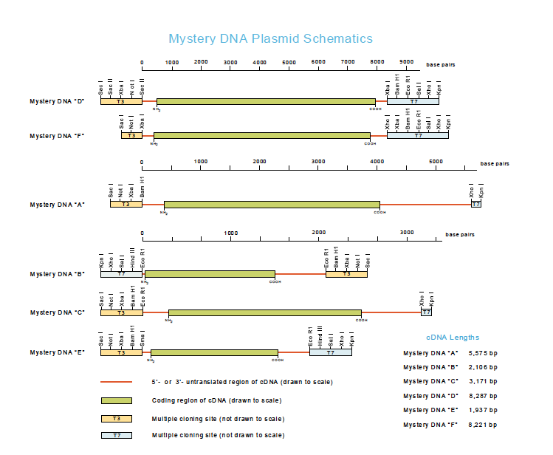

Slide 9
An example with steps —not your digest, necesssarily
1) Take each mystery gene, and find out the restriction sites using NEBcutter.
2) Figure out the number of fragments and their size for use with a given digest.
3) Make a table for the expected values fro a given protocol.
4) Make a restriction map of the plasmid + insert identifying the base pair at which cuts could be expected.

Slide 11
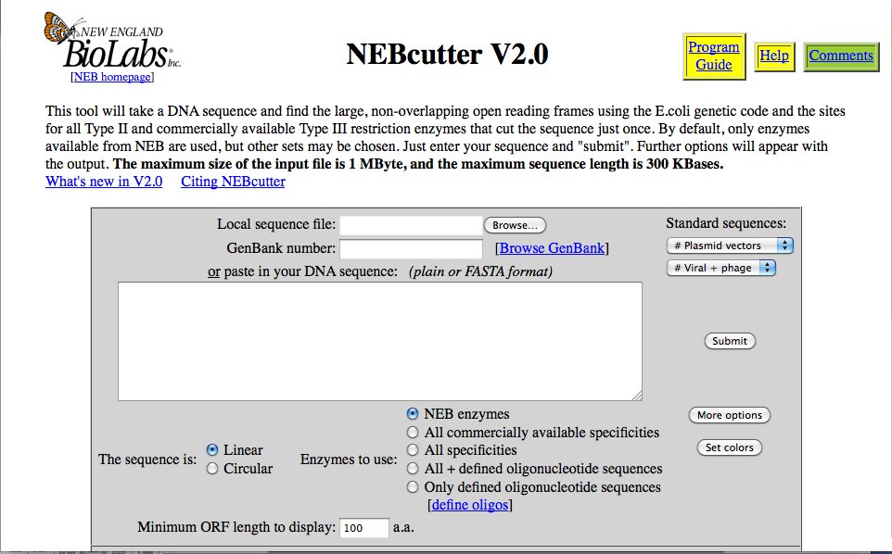
Paste genbank # here.
Or paste the sequence of
entire gene here.
Notes:
From
http://tools.neb.com/NEBcutter2/index.php

Slide 12
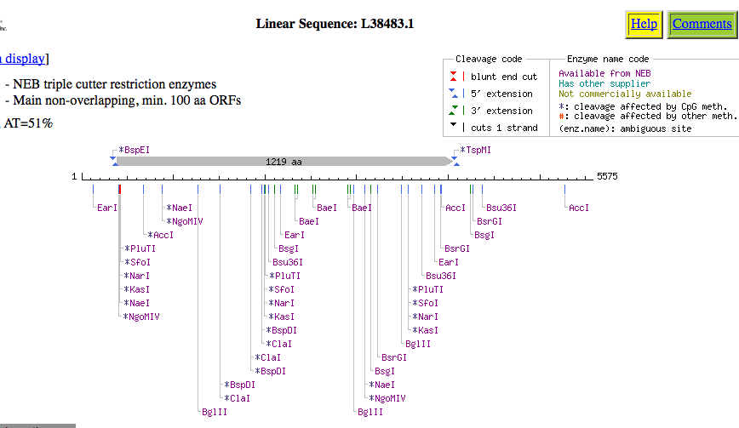
129
2174
3853
Notes:
From
http://tools.neb.com/NEBcutter2/index.php

Slide 13
2961 Bp
Notes:
From
http://www.bio.davidson.edu/Courses/Molbio/MolStudents/spring2003/Keogh/plasmids.html#basicplasm

Slide 15
An example with steps —not your digest, necesssarily
1) Take each mystery gene, and find out the restriction sites using NEBcutter.
2) Figure out the number of fragments and their size for use with a given digest.
3) Make a table for the expected values fro a given protocol.
4) Make a restriction map of the plasmid + insert identifying the base pair at which cuts could be expected.

Slide 16
Predicted band size for made-up protocol for mystery DNA A—Jagged protein

Slide 17
Things that you need to accomplish in week 1 for your lab report
1) Make a table of the number of predicted fragments and size for each protocol for each of the 6 mystery DNAs.
2) For each mystery DNA, draw a map of where the various restriction endonuclease enzymes used in the protocol would have cut in the insert and in the vector (multiple cloning site)—insert should be to scale but the vector need not be.

Slide 18
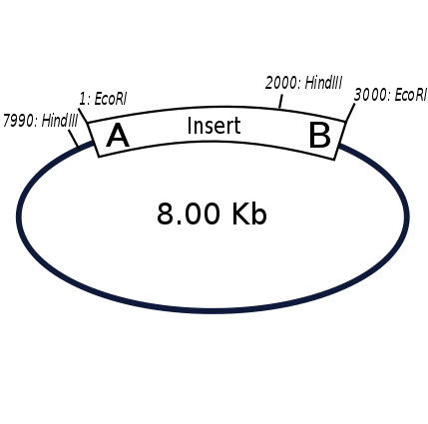
Notes:
From
http://en.wikipedia.org/wiki/Restriction_map

Slide 19
Summary
By end of today should have a table for each of the mystery cDNAs predicting the size of fragments for each digest in the protocol
Can draw the restriction maps outside of class

